Slide 1
HACKFEST 2026
By Innovation Council
Endpoint AI Workstation
Ignite Ideas. Build the future.

Slide 2
01 / STORY
Problem & Solution Overview
From scattered diagnostic logs to a trusted, evidence-backed case report — automatically.
01
02
PROBLEM STATEMENT
TARGET AUDIENCE
Diagnosing a failing Windows endpoint means manually correlating 17 folders of raw logs — event logs, crash dumps, hardware and resource data — a slow process that depends on deep expertise.
IT helpdesk technicians, endpoint reliability engineers and sysadmins who triage enterprise laptop and desktop failures.
03
04
YOUR SOLUTION
VALUE PROPOSITION
Endpoint AI Workstation ingests a diagnostic folder or ZIP, auto-detects anomalies across 9 categories, and builds a tiered, evidence-cited root-cause report with safe remediation scripts.
Every finding is source-cited and confidence-scored across 4 tiers — not a black box. An optional Luna 5.6 chat lets technicians ask follow-ups grounded in the case’s own evidence.
BEFORE → AFTER
Before: hours of manual log correlation per incident. After: a cited, tiered case report and a ready-to-run remediation script in minutes.

Slide 3
02 / SOLUTION
Detailed Solution
A deterministic diagnosis engine paired with grounded RCA — every claim traces back to a cited source file.
A
B
C
INNOVATION & ORIGINALITY
SCALABILITY
ROLE OF AI & COST EFFECTIVENESS
Evidence chains, not guesses.
Statistical Z-score/IQR micro-spike detection, monotonic memory-leak regression and multi-process crash-cluster correlation feed a local RCA agent that builds cited evidence chains instead of LLM guesses.
Built to generalize, not one device.
Modular per-category detectors generalize to any 17-module diagnostic capture. Accepted case RCAs feed back into the RAG knowledge base, so it improves with every case solved.
Detection and RCA run offline at zero cost via rules plus hybrid BM25/semantic RAG. Luna 5.6 is strictly opt-in — used only to narrate findings and power case chat, never for core detection.
EVIDENCE-BACKED
Each RCA states its evidence chain and a confidence percentage — e.g. install-date proximity → crash-timeline position → crash signature → cascading pattern.

Slide 4
03 / DEMO
How It Works
The pipeline from raw endpoint logs to a cited case report and safe remediation.
01
02
03
04
INPUT
INTELLIGENCE
ACTION
OUTCOME
Folder or ZIP upload
17-module Windows diagnostic capture
Diagnosis Engine + RCA Agent
9-category detectors, then grounded root-cause evidence chains
Scripts + RAG search
Self-healing PowerShell with dry-run & rollback
Cited case report
Tiered findings, PDF/MD/SIEM export, ready-to-run scripts
KEY FEATURES
TECH STACK
DEMO LINK OR SCREENSHOTS
Confidence-scored findings across 4 tiers, self-healing PowerShell with dry-run + rollback, and a knowledge base that learns from every accepted case.
Python, Streamlit, pandas/Altair, ReportLab, Okapi BM25 + SentenceTransformers (RAG), optional Luna 5.6 LLM via Azure AI Inference.
Streamlit app: Overview, Findings, Root Cause, Knowledge, Actions, Community and Luna Chat tabs — all driven by one diagnostic capture.

Slide 5
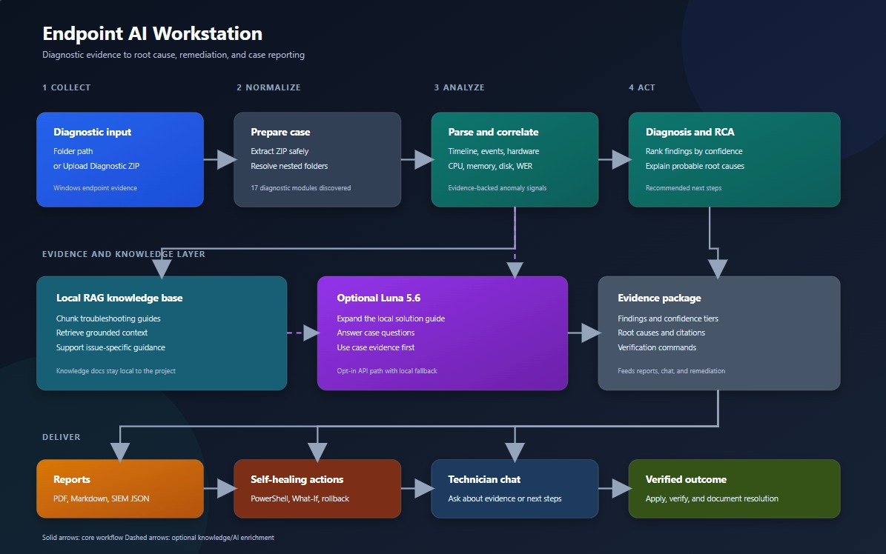
04 / ARCHITECTURE
Solution Architecture
Collect → Normalize → Analyze → Act, backed by a local knowledge layer and optional Luna 5.6.

Slide 6
06 / ADVANCED CAPABILITIES
Advanced Capabilities
Deep statistical detection turns raw telemetry into a defensible investigation trail.
MULTI-SOURCE CORRELATION
A
RANKED EVIDENCE
B
Correlates 17 diagnostic folders into one evidence-based workstation assessment.
Uses confidence scoring and ranked evidence to trace each finding to exact files, events, and telemetry.
STATISTICAL ANALYTICS
C
TRUSTED INVESTIGATION TRAIL
D
Detects micro-spikes, memory leaks, temporal clusters, and crash patterns using statistical analytics.
Creates a trusted investigation trail instead of a black-box AI guess.

Slide 7
07 / RAG + LOCAL KNOWLEDGE
RAG + Local Knowledge
Grounded retrieval over a live knowledge base — not generic LLM guesswork.
GROUNDED RETRIEVAL
A
EVIDENCE-GROUNDED RCA
B
Blends local troubleshooting guides with targeted retrieval over crash codes, event IDs, and anomaly symptoms.
Grounds root-cause explanations in the local knowledge base, not just generic LLM output.
LEARNING LOOP
C
INCIDENT PLAYBOOKS
D
Stores validated RCA cases back into the knowledge base to improve future investigations.
Supports incident-specific playbooks for faster troubleshooting decisions.

Slide 8
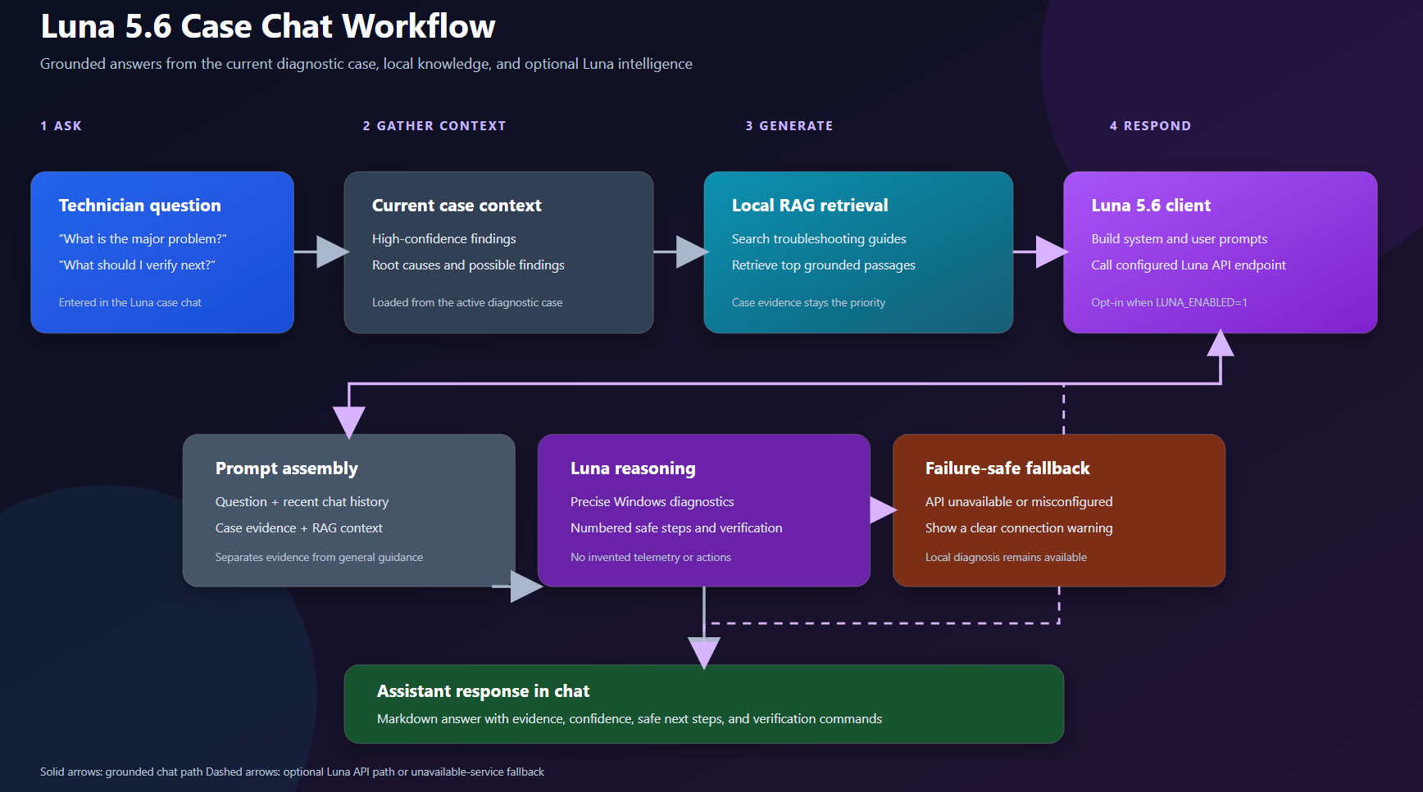
08 / LUNA CASE CHAT
Luna 5.6 Case Chat Workflow
Grounded answers from the current diagnostic case, local knowledge, and optional Luna intelligence.

Slide 9
09 / SELF-HEALING ACTIONS
Self-Healing Actions
From diagnosis to execution-ready PowerShell remediation, safely.
AUTOMATED REMEDIATION
A
SAFE BY DEFAULT
B
Generates PowerShell remediation scripts for detected root causes and recommended actions.
Built with dry-run support through -WhatIf, rollback, and system restore protection.
GUARDED EXECUTION
C
FROM ANALYSIS TO ACTION
D
Checks admin requirements and safe execution paths before altering the environment.
Turns the solution from a passive analyzer into an execution-ready engineering workflow.

Slide 10
11 / WHY IT MATTERS
Why It Matters
An end-to-end platform for evidence-first endpoint diagnosis and remediation.
END-TO-END PLATFORM
A
BUILT FOR TRUST
B
This is not just a report generator; it is an end-to-end diagnosis, RCA, knowledge, and remediation platform.
Evidence-first reasoning, grounded knowledge retrieval, and safe automation increase trust in frontline operations.
ENTERPRISE-READY
C
THE ROADMAP
D
Built for real enterprise support teams that need speed, consistency, and operational clarity.
The roadmap includes broader OS coverage, fleet-scale analysis, and deeper automation.

Slide 11
05 / IMPACT
Impact & Future Scope
From a working diagnostic tool to a platform that helps every case it closes.
01
02
03
IMPACT
MARKET POTENTIAL / USE CASES
NEXT STEPS
Collapses hours of manual log triage into one automated pass. Every finding is source-cited and confidence-scored, and every remediation script ships with dry-run + rollback safety.
Enterprise IT helpdesk and endpoint reliability teams today; extends to server fleets, other OS diagnostic bundles, and any evidence-based troubleshooting domain.
Add network, boot-time and battery detectors; correlate findings across a device fleet; tighter Luna integration to auto-draft incident tickets.
TEAM & ROLES
Niranjan • Complete execution of Endpoint work-station end to end with Fine tunning
Dhanasekar • Concept Development
Bharathi • Concept Development
Abilash • Testing
Godfrey • Testing
READY TO PITCH

Slide 12
Thank You

